Slide 1


DEPARTMENT OF PHYSICS AND NANOTECHNOLOGY
SRM INSTITUTE OF SCIENCE AND TECHNOLOGY
18PYB103J –Semiconductor Physics
LECTURE 2
DENSITY OF STATES
18PYB103J Module-I Lecture-2

Slide 2
Introduction
The free-electron theory of metals describes the electrons as roaming freely around and about the entire solid metal.
It turns out that although electrons can move about the solid metal, they have a very hard time actually escaping the surface of the metal under normal conditions.
Since the electrons remain trapped in the metal, we can imagine that the metal serves as a finite potential well (rigid-box) in which the electrons can move about with zero potential energy but cannot actually escape into the environment as a result of the high electric potential barrier that exists on the surface of the metal.
18PYB103J Module-I Lecture-2

Slide 3
Although quantum tunneling can lead to an electron escaping into the environment, this is very rare and usually does not happen.
Quantum mechanics tells us that electrons must obey the Pauli exclusion principle and only two electrons can go into any quantum state with the same energy. The question that we might ask is "how many quantum states are there in the metal solid?".
As it turns out, the mathematical function that represents the number of quantum states of the electrons in the metal atom per unit volume per unit energy is defined as the density of states.
18PYB103J Module-I Lecture-2

Slide 4
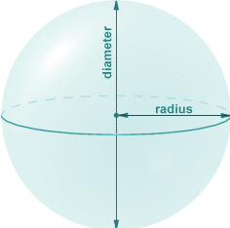
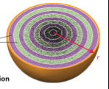
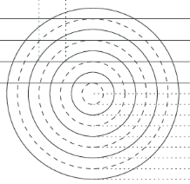
DENSITY OF STATES
The one-dimensional free electron model can be improved by considering the three-dimensional case: electrons moving freely in a three-dimensional metal block.
To find the number of energy levels in a cubical
metal piece and to find number of electrons
that can be filled in a given energy level,
Let us construct a sphere of radius ‘n’ in the space
The sphere is further divided in to many shells and each of this shell represents a particular combination of quantum numbers (nx, ny, and nz) and therefore represents a particular energy value.
18PYB103J Module-I Lecture-2

Slide 5
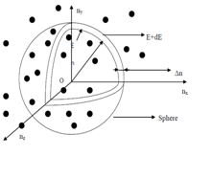

Let us consider two energy values E and E + dE.
The number of energy states between E and E + dE can be found by finding the number of energy states between the shells of the radius n and n + Δn, from the origin.
The number of energy states within the sphere of radius n = 4/3 π n³
Since nx, ny, and nz will have only positive values, we have to take only one octant of the sphere (i.e) 1/8 th of the sphere volume.
n + Δn
n
18PYB103J Module-I Lecture-2

Slide 6
The number of available energy states within the sphere of radius n or energy E
n = 1/8 [4/3 π n³]
Similarly the number of available energy states within the sphere of radius n + dn or energy E+dE
n + dn = 1/8 [4/3 π (n+dn)³]
The number of available energy states between the shells of radius n and n + dn (or) between the energy levels E and E + dE
Z(E)dE =
1/8 [4/3 π (n+dn)³- 4/3 π n³ ]
18PYB103J Module-I Lecture-2

Slide 7
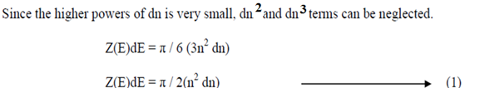
The number of available energy states between the energy interval
Z(E)dE = 1/8 X 4/3 π [n³+dn³+3n²dn+3dn²n- n³]
18PYB103J Module-I Lecture-2

Slide 8
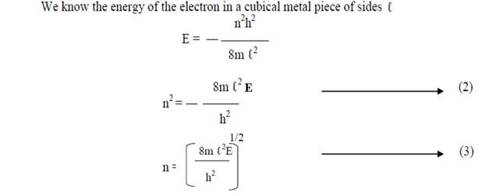
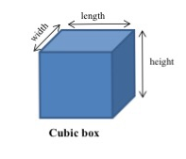
18PYB103J Module-I Lecture-2

Slide 9
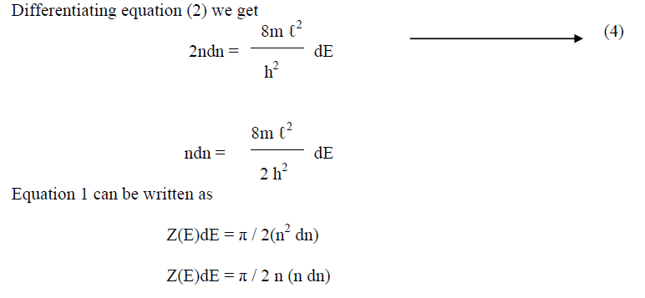
18PYB103J Module-I Lecture-2

Slide 10
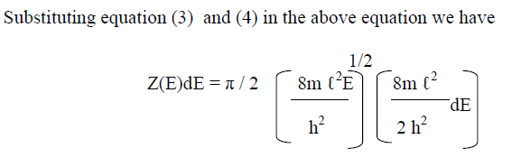
18PYB103J Module-I Lecture-2

Slide 11
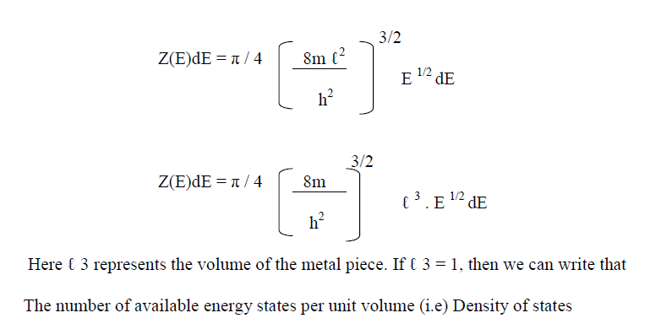

18PYB103J Module-I Lecture-2

Slide 12
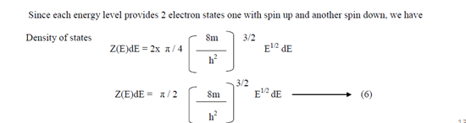
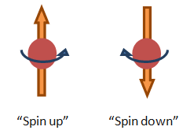
Associated with each set of quantum numbers (nx,ny,nz)(nx,ny,nz) are two quantum states, spin up and spin down.
In a real material, the number of filled states is enormous. For example, in a cubic centimeter of metal, this number is on the order of 1022.
Counting how many particles are in which state is difficult work, which often requires the help of a powerful computer. The effort is worthwhile, however, because this information is often an effective way to check the model.
18PYB103J Module-I Lecture-2

Slide 13
Significance of Density of States
The density of states (DOS) is essentially the number of different states at a particular energy level that electrons are allowed to occupy, i.e. the number of electron states per unit volume per unit energy.
DOS helps determine the general distribution of energy states as a function of energy and
Determine the spacing between energy bands in semi-conductors.
Bulk properties such as
Specific heat
Paramagnetic susceptibility, and
Other transport phenomena of conductive solids depend on this function.
The calculation of some electronic processes like
Absorption
Emission
The general distribution of electrons in a material require us to know the number of available states per unit volume per unit energy.

Slide 14
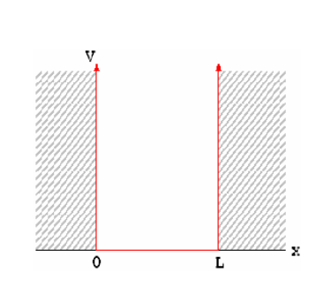
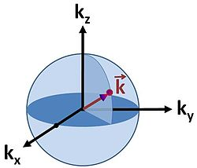
The density of states in a semiconductor equals the density per unit volume and energy of the number of solutions to Schrödinger's equation.
Assumption- that the semiconductor can be modeled as an infinite quantum well in which electrons with effective mass, m*, are free to move.
The energy in the well is set to zero. The semiconductor is assumed a cube with side L.
An example of a 3-dimensional k-space is given in Fig. 1. It can be seen that the dimensionality of the system confines the momentum of particles inside the system.

Slide 15
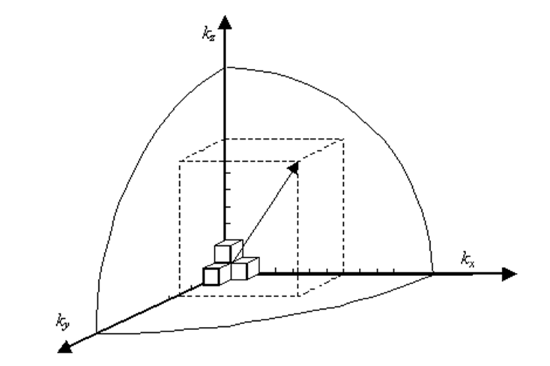
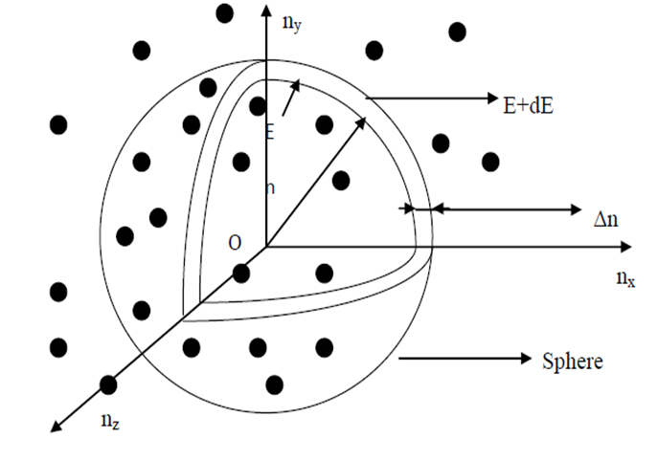
A cubical metal piece k space(k, represents wave vector)
Quantum mechanics provides two fundamental examples of the duality between position and momentum, the Heisenberg uncertainty principle ΔxΔp ≥ ħ/2 stating that position and momentum cannot be simultaneously known to arbitrary precision, and the de Broglie relation p = ħk which states the momentum and wavevector of a free particle are proportional to each other.

Slide 16
Consider a solid metal cube of edge length 2.0 cm.
What is the lowest energy level for an electron within the metal?
What is the spacing between this level and the next energy level?
18PYB103J Module-I Lecture-2

Slide 17
Strategy
An electron in a metal can be modeled as a wave. The lowest energy corresponds to the largest wavelength and smallest quantum number: nx, ny,nz=(1,1,1)
Since the energy of the electron increases with the quantum number, the next highest level involves the smallest increase in the quantum numbers, or (nx, ny,nz)=(2,1,1),(1,2,1) or (1,1,2).
18PYB103J Module-I Lecture-2

Slide 18
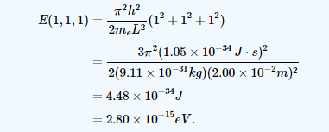
Solution
The lowest energy level corresponds to the quantum numbers nx=ny=nz=1
18PYB103J Module-I Lecture-2

Slide 19
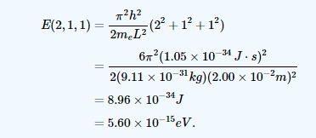
The next-higher energy level is reached by increasing any one of the three quantum numbers by 1. Hence, there are actually three quantum states with the same energy. Suppose we increase nx by 1. Then the energy becomes
18PYB103J Module-I Lecture-2

Slide 20
The energy spacing between the lowest energy state and
the next-highest energy state is therefore
E(2,1,1)−E(1,1,1)=2.80×10−15eV.
Significance
This is a very small energy difference.
Compare this value to the average kinetic energy of a particle,
kBT, where kB is Boltzmann’s constant and T is the absolute temperature.
The product kBT is about 1000 times greater than the energy spacing.
18PYB103J Module-I Lecture-2

Slide 21
Thank you
18PYB103J Module-I Lecture-2

